Slide 1
Project_milestone2
File created on: 1/27/21 4:28:00 PM CST

Slide 2
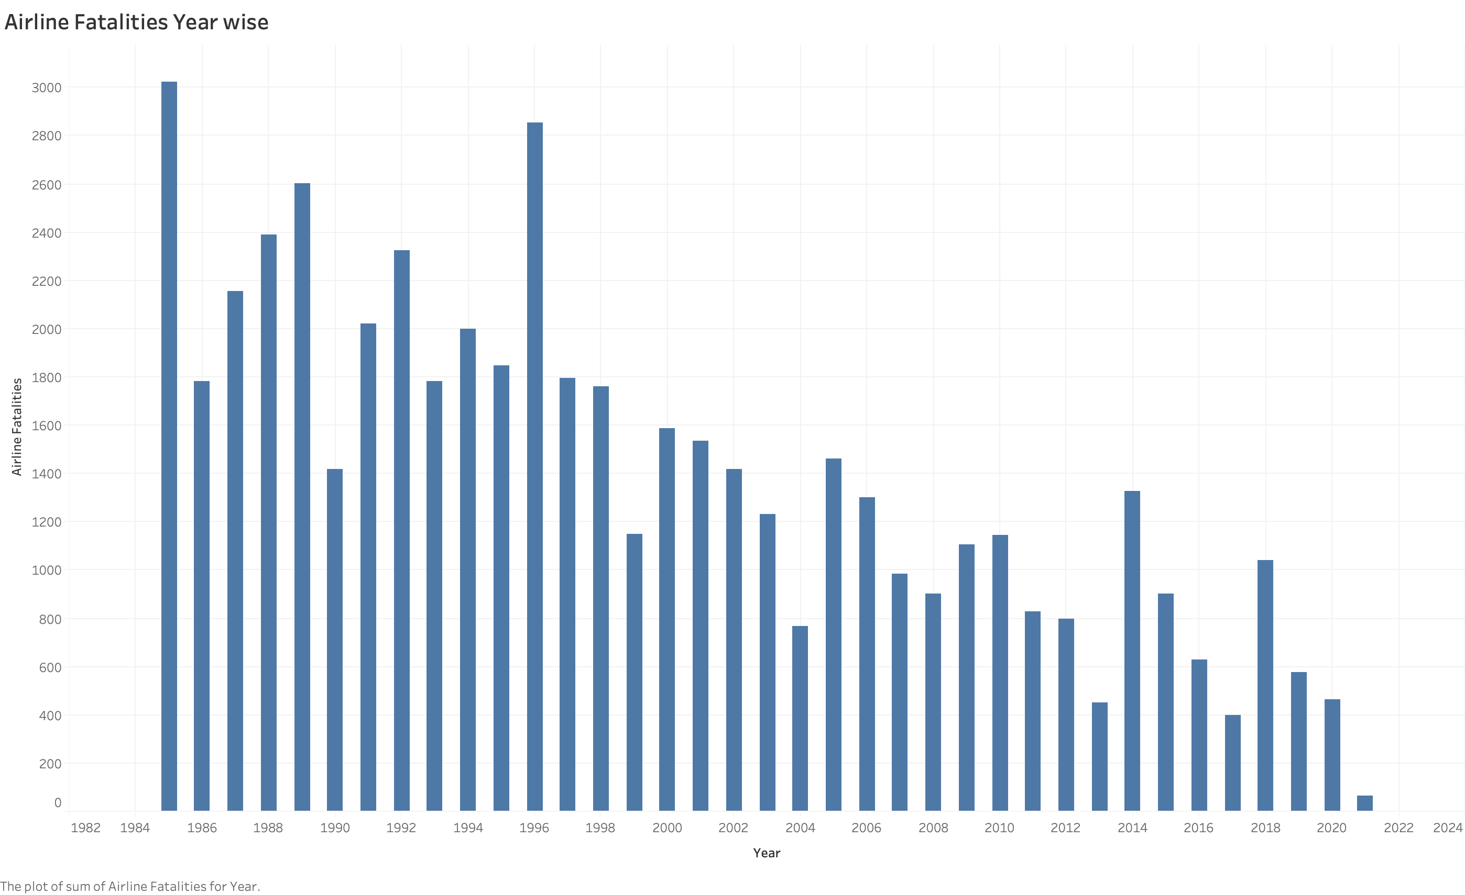

Slide 3


Slide 4
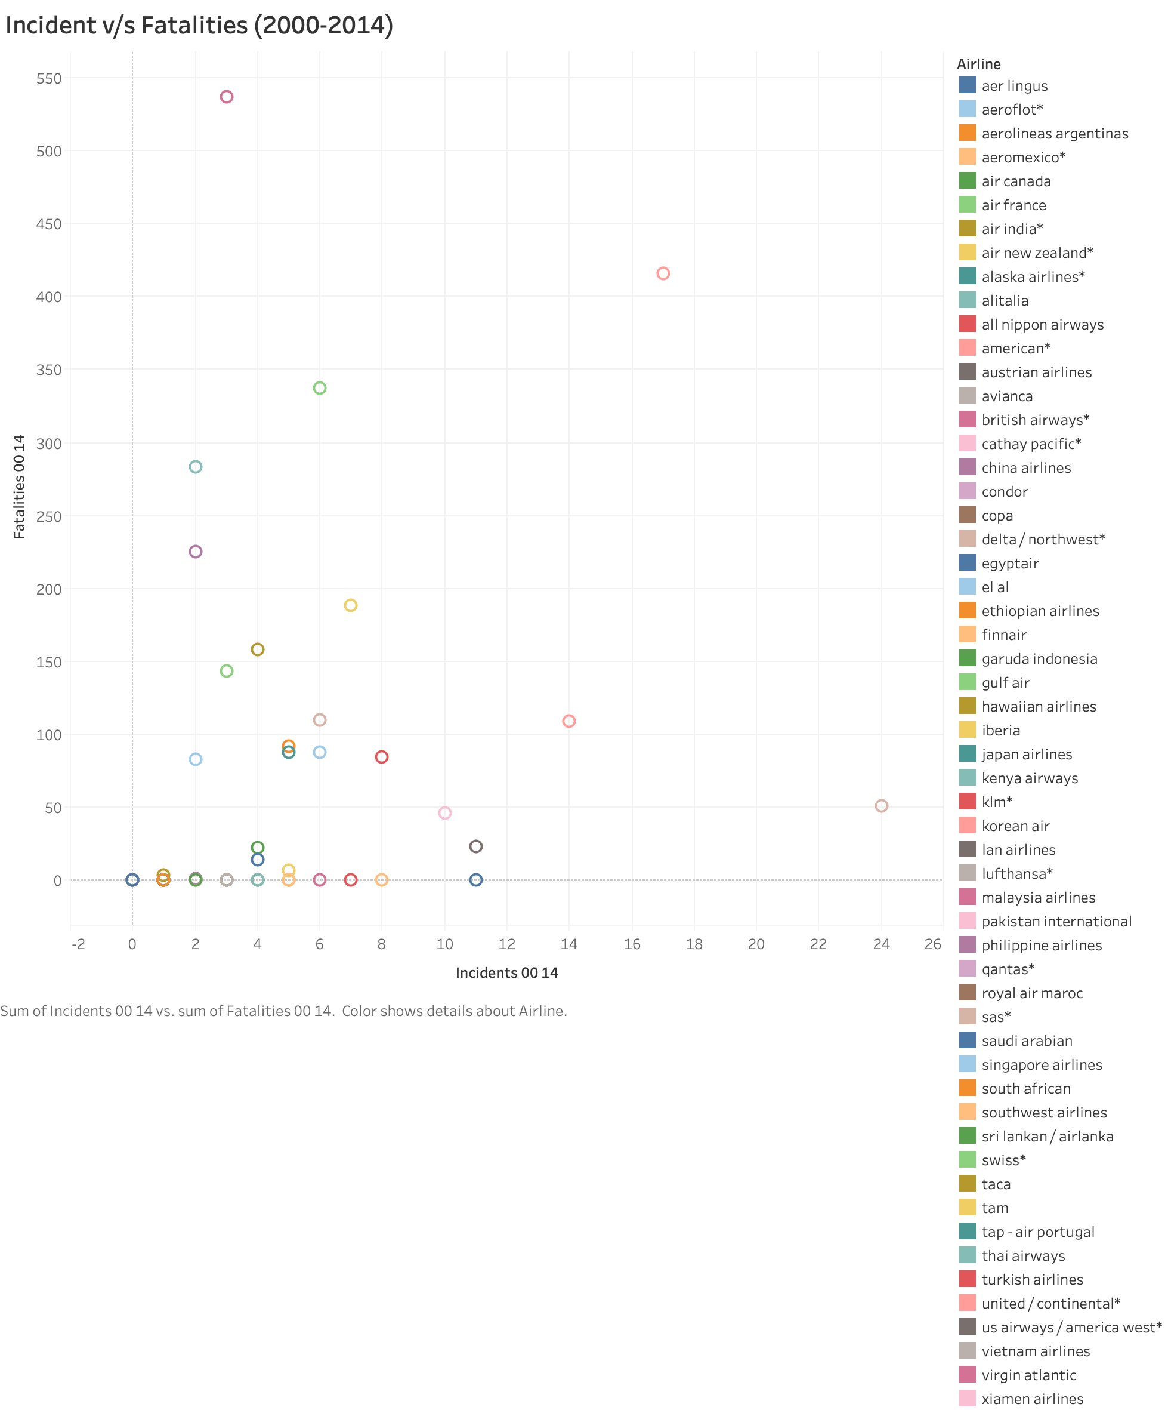

Slide 5
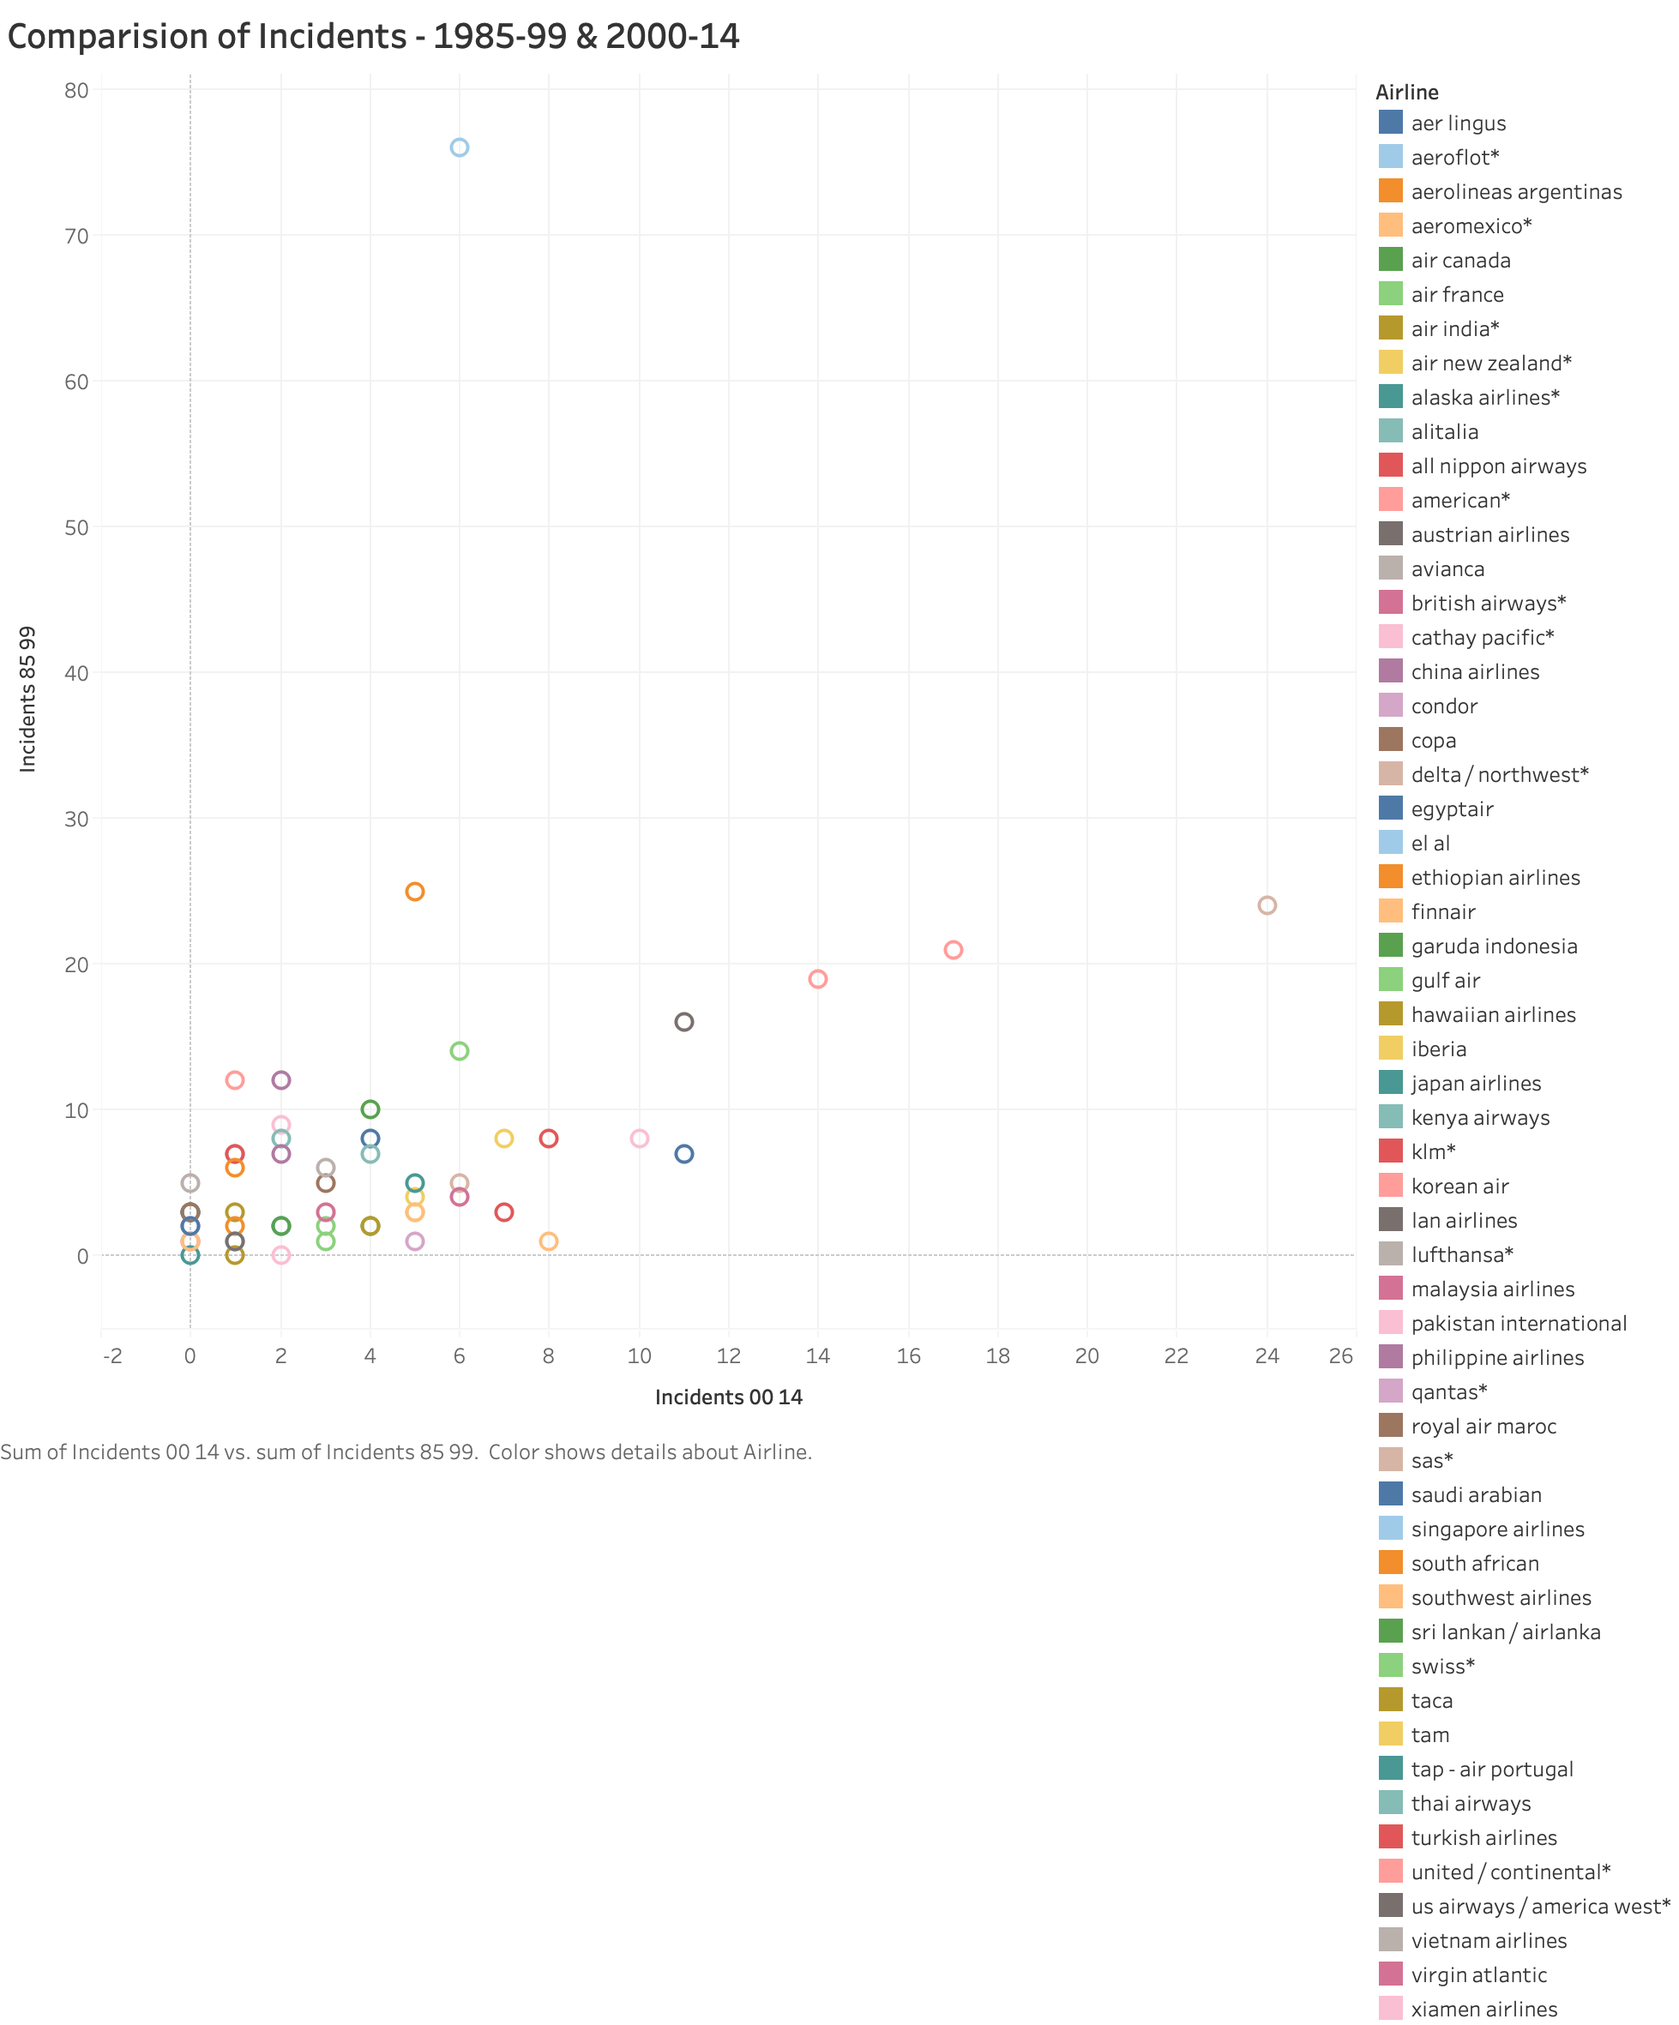

Slide 6
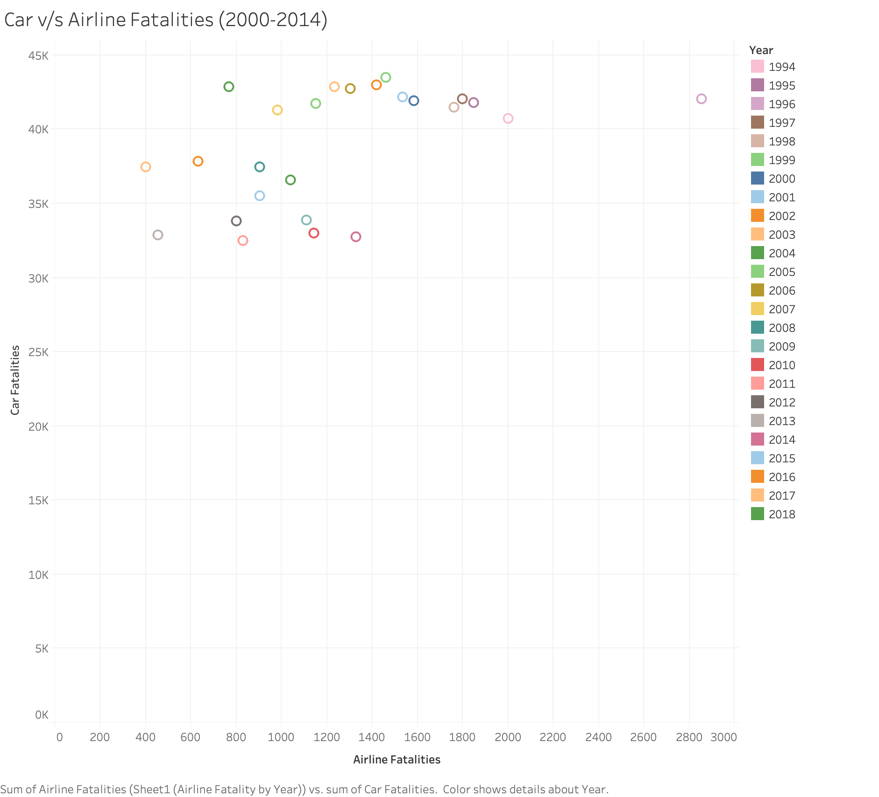

Slide 7
